Slide 1
Annual Report Guide
ANKLESARIA_{GROUP}
30 Years Of Excellence

Slide 2
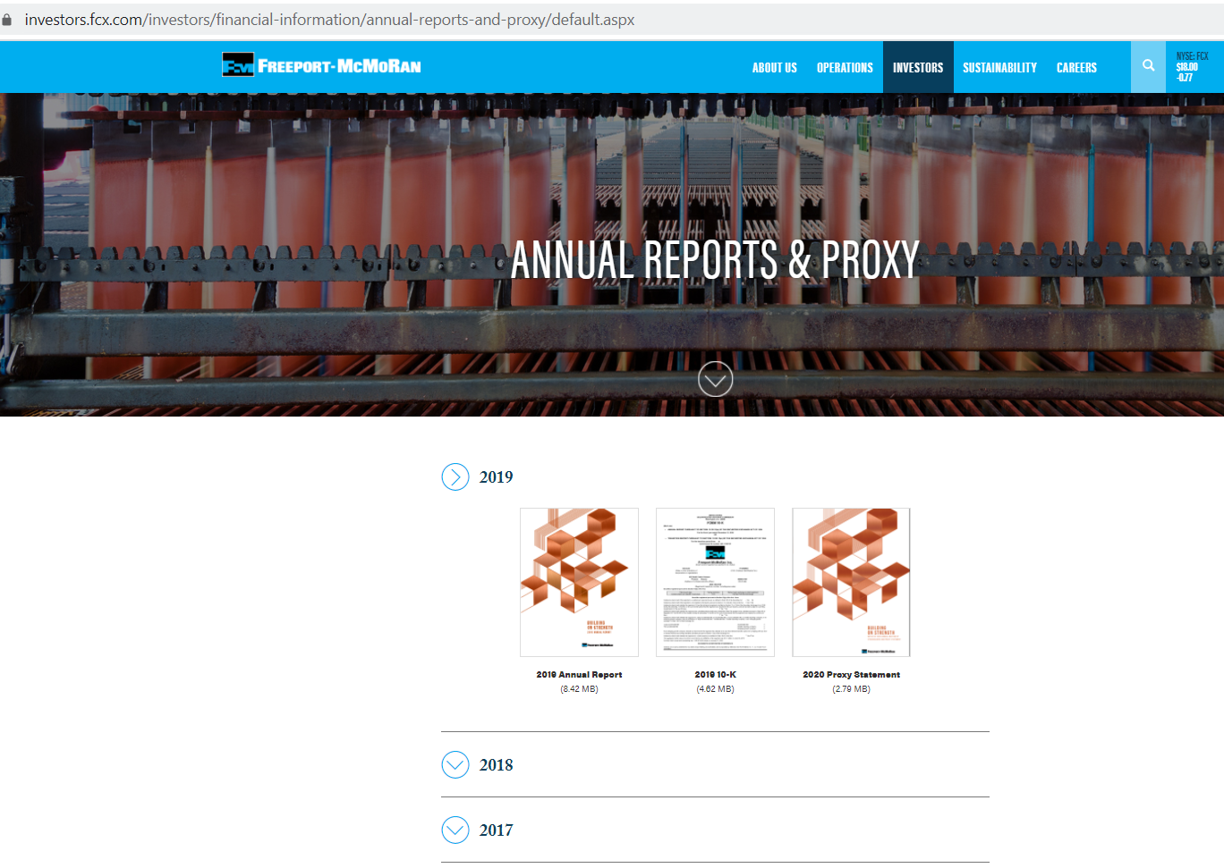
Search for and download the Annual Report
The Annual Report of a company is available on the company website under the “Investor” tab for publicly listed companies
Download the latest Annual Report
ANKLESARIA _{GROUP}
30 Years Of Excellence

Slide 3
Market Analysis, SWOT & Price Drivers
ANKLESARIA_{GROUP}
30 Years Of Excellence

Slide 4
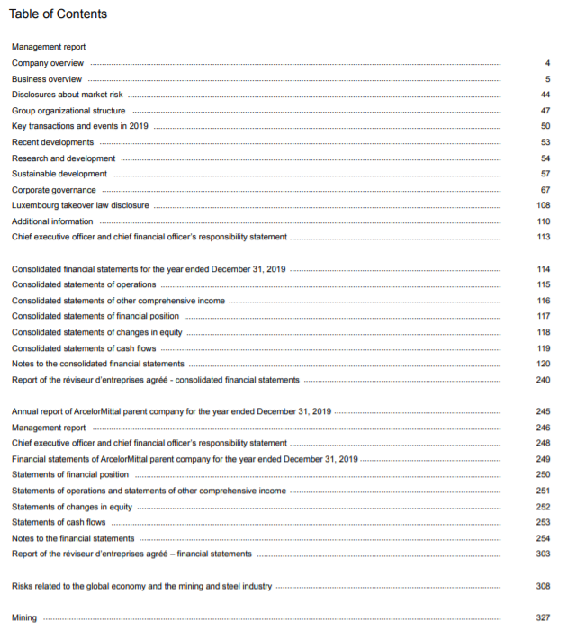
Search for and extract data that can help with Market Analysis, Price Drivers and SWOT
Sample 1- Arcelor Mittal
Once downloaded, open the pdf file and go to the ‘Table of Contents’
Follow the Table of Contents to find data on Company Overview, Business Overview, Market Risks and Organisational structure
ANKLESARIA _{GROUP}
30 Years Of Excellence

Slide 5
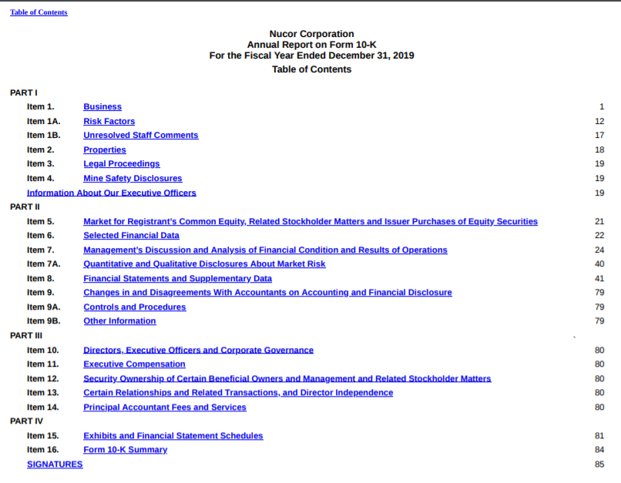
Search for and extract data that can help with Market Analysis, Price Drivers and SWOT
Sample 2- Nucor Corporation
Once downloaded, open the pdf file and go to the ‘Table of Contents’
Follow the Table of Contents to find data on Company Overview, Business Overview, Market Risks and organisational structure
ANKLESARIA _{GROUP}
30 Years Of Excellence

Slide 6
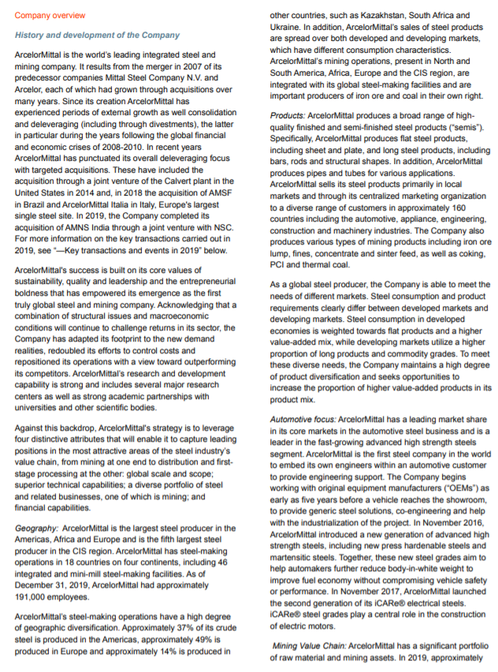
Search for and extract data that can help with Market Analysis, Price Drivers and SWOT
Arcelor Mittal Annual Report
Under the ‘Company Overview’ section you can find valuable information on the following:
Number of Business Units, Functions of each Business units, Geographical distribution of Company units, Products manufactured, Business sectors catered, Number of employees
ANKLESARIA _{GROUP}
30 Years Of Excellence

Slide 7
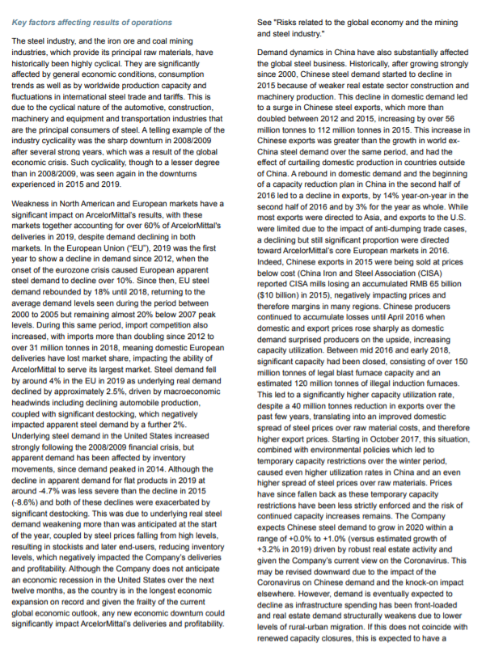
Search for and extract data that can help with Market Analysis, Price Drivers and SWOT
Arcelor Mittal Annual Report
Under the ‘Business Overview and Risks’ section you can find valuable information on the following:
Supply Market Overview Data (can be used in determining Price drivers) and Business Risks ( can be used in the company SWOT)
ANKLESARIA _{GROUP}
30 Years Of Excellence

Slide 8
Financial Health Tool
ANKLESARIA_{GROUP}
30 Years Of Excellence

Slide 9
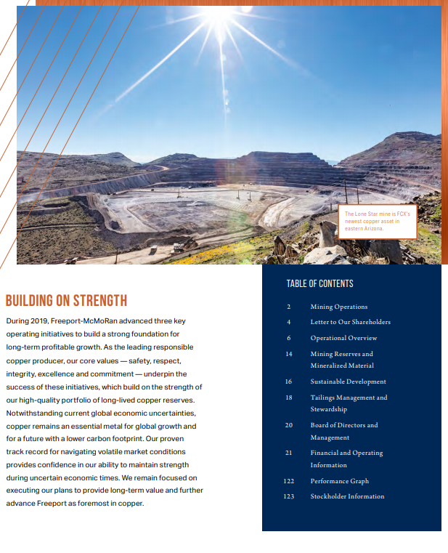
Search for and extract data required to conduct a financial health analysis
Once downloaded, open the pdf file and go to the ‘Table of Contents’
Follow the Table of Contents to find data on selected financial statements
ANKLESARIA _{GROUP}
30 Years Of Excellence

Slide 10
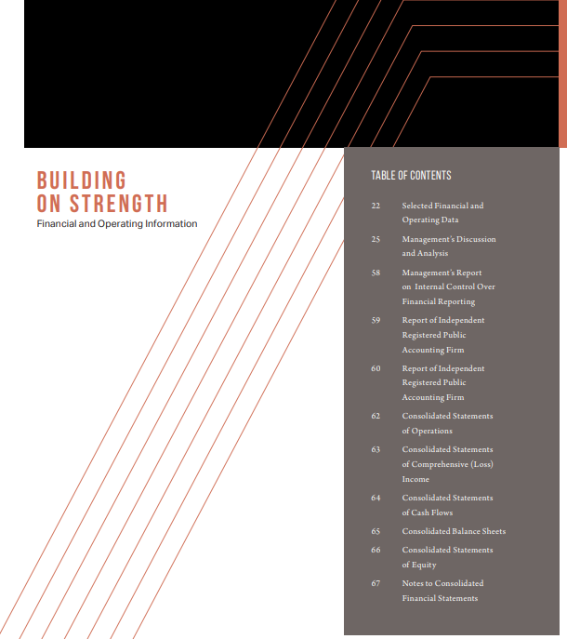
Step 2: Search for and extract data required to conduct a financial health analysis
Navigate to the selected financial statements section with the help of the page number mentioned in the table of contents
Look for ‘Consolidated Statement of Income’, ‘Consolidated Statement of Cash Flow’ and ‘Consolidated Balance Sheet’
ANKLESARIA _{GROUP}
30 Years Of Excellence

Slide 11
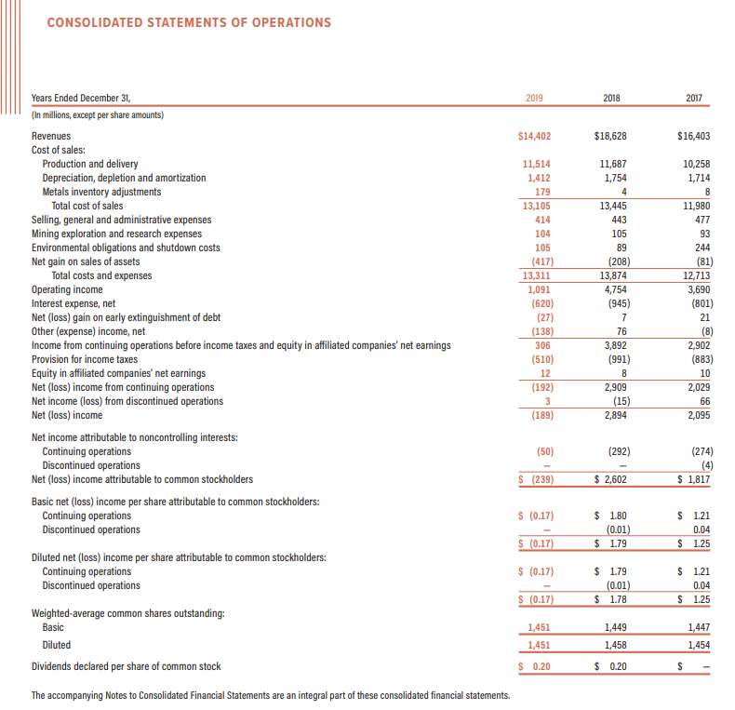
Step 2: Search for and extract data required to conduct a financial health analysis
Under ‘Consolidated Statement of Income’ note down the following values
1) Revenue/Sales
2) Cost of Sales
3) Operating Income
4) Net Interest Expense
5) Net Profit after Taxes
ANKLESARIA _{GROUP}
30 Years Of Excellence

Slide 12
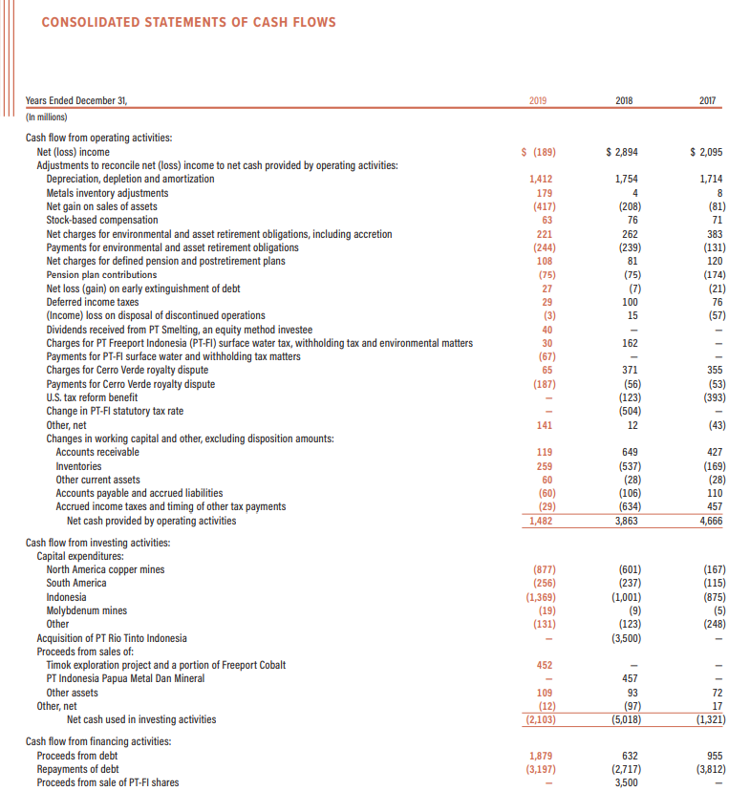
Step 2: Search for and extract data required to conduct a financial health analysis
Under ‘Consolidated Statement of Cash Flow’ note down the following values
1) Net cash from Operating activities
ANKLESARIA _{GROUP}
30 Years Of Excellence

Slide 13
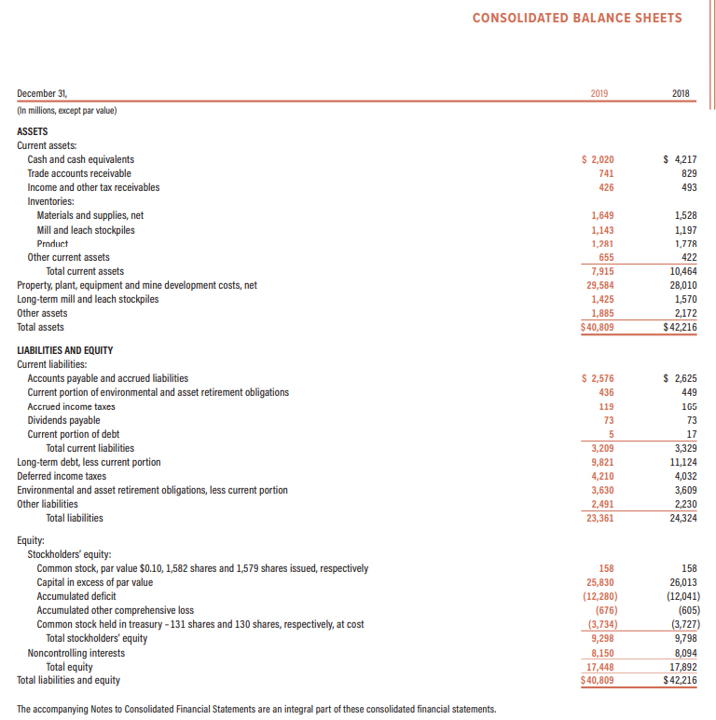
Step 2: Search for and extract data required to conduct a financial health analysis
Under ‘Consolidated Balance Sheet’ note down the following values
1) Current Assets
2) Account Receivables
3) Inventory
4) Total Assets
ANKLESARIA _{GROUP}
30 Years Of Excellence

Slide 14
Step 2: Search for and extract data required to conduct a financial health analysis
Under ‘Consolidated Balance Sheet’ note down the following values
5) Current Liabilities
6) Total Liabilities
7) Total Shareholder’s Equity
ANKLESARIA _{GROUP}
30 Years Of Excellence

Slide 15
Notes to Financial Statements
ANKLESARIA _{GROUP}
30 Years Of Excellence

Slide 16
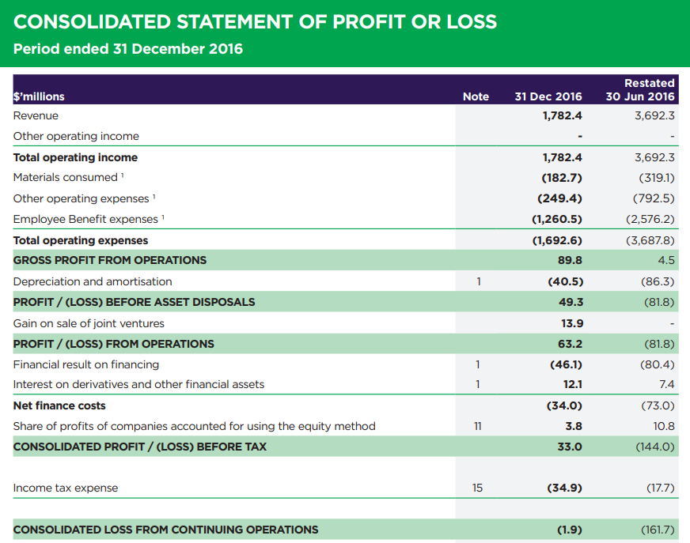
Notes to Financial Statements
Sometimes the details provided in the Income Statement or Balance sheet are not enough to obtain the data required for the Financial Health Tool. In such cases, one can refer to the Notes to Financial Statements to get further details on the cost element of interest. Kindly refer the example shared below from Broad Spectrums Annual Report.
In this example, the Net Interest Expense is not directly displayed on the Income statement. To find the Net Interest Expense, kindly refer to the cost element titled ‘Financial Result on financing’
Follow the number highlighted here to navigate the notes to financial statements. In this example, refer to Note number 1
ANKLESARIA _{GROUP}
30 Years Of Excellence

Slide 17
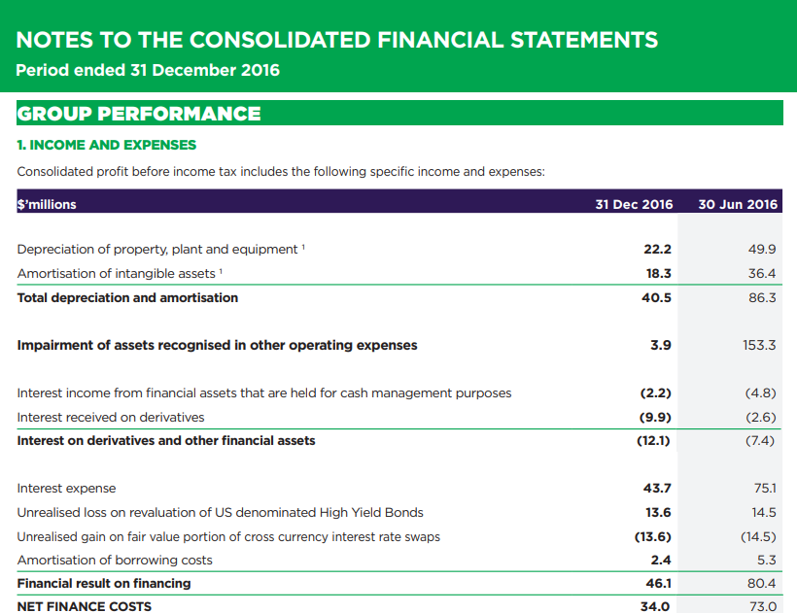
Notes to Financial Statements
Navigate to Note Number 1
Find the value for Interest expense and note down the same.
ANKLESARIA _{GROUP}
30 Years Of Excellence

Slide 18
THANK YOU
ANKLESARIA _{GROUP}
30 Years Of Excellence

